Slide 1
State Machine

Slide 2
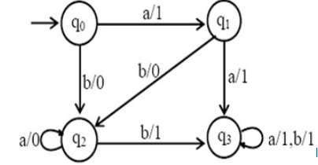
Mealy Machine

Slide 3
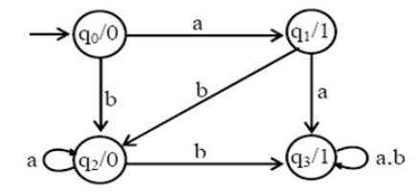
Moore Machine

Slide 4
Mod – 3 Moore machine

Slide 10
101 pattern detector with Moore machine

